Slide 1


Investor Pitch Overview

Slide 2
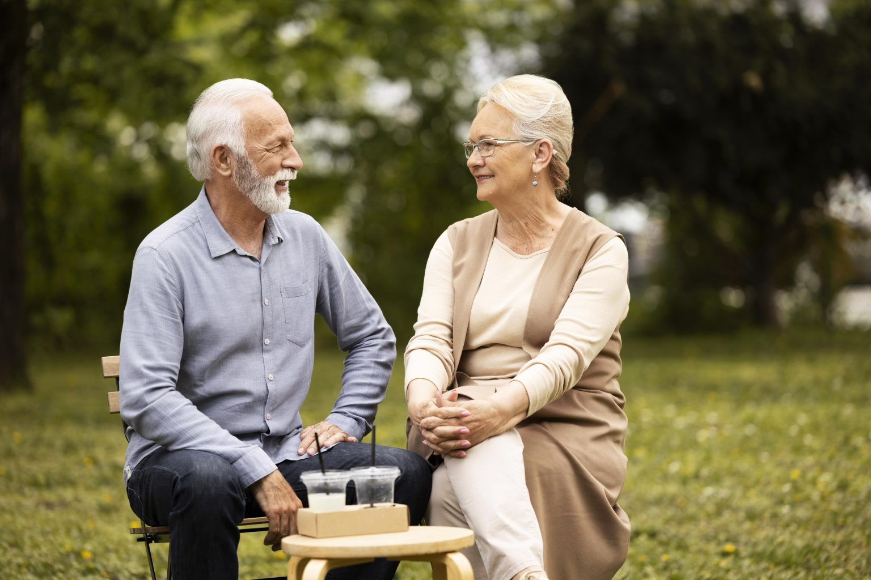
Introduction
Granhub, a platform designed to bridge the gap between generations and create meaningful connections in modern family life.
Today, families are more spread out than ever — geographically, culturally, and digitally. Grandparents want to be more than occasional babysitters; they want to share wisdom, values, and experiences. Parents want support. Grandchildren crave connection. Granhub exists to meet this need.

Slide 3

Our Mission
To empower grandparents and families by providing digital tools, resources, and community spaces that foster intergenerational connection.
We don’t just want to provide content — we want to create a movement where families learn, play, and grow together.

Slide 4

The Problem
Over 40% of grandparents in the UK live more than an hour away from their grandchildren.
Seniors often feel left out of digital-first family communication.
Families are looking for safe, supportive, and engaging platforms to connect across generations.
Existing social media is either too general, too commercial, or unsafe for deep family interactions. There’s no single trusted hub focused specifically on grandparent–grandchild relationships.

Slide 5

Our Solution:
Granhub is an intergenerational lifestyle and community platform with curated content, events, and tools.
Grandparenting Tips – expert advice on relationships and roles.
Recipes & Cooking – family meals and shared traditions.
Family Activities – fun, screen-free bonding experiences.
Health & Wellness – age-friendly, family-oriented wellbeing.
Travel & Leisure – curated guides for multi-generational trips.
Technologies to Know – making digital tools accessible for seniors.
Crafts & Hobbies – creative activities across generations.
Personal Stories – real voices from families.
Community Events – local and online gatherings.

Slide 6
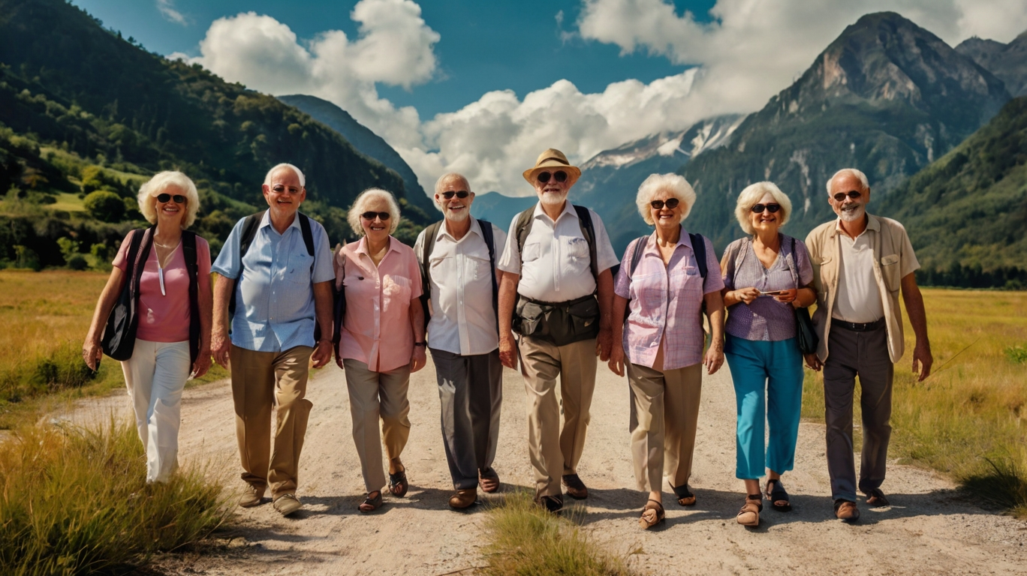
Value Proposition
For Families:
A trusted, inspiring resource to stay connected and active together.
For Partners & Sponsors:
A high-trust audience in a growing niche: seniors + family lifestyle.
For Investors:
Multiple revenue streams with scalability across the UK and beyond.

Slide 7


Revenue Model
Premium Memberships (exclusive webinars, downloadable guides, event discounts).
Sponsored Content & Partnerships (brands in wellness, travel, food, tech for seniors).
Events & Workshops (both online and offline, ticketed).
Affiliate Sales (books, crafts, travel packages, tech tools).
Community Marketplace (future expansion: family-friendly products and services).

Slide 8
Market Opportunity
UK has 14+ million grandparents, many actively involved in family life.
The senior wellness and lifestyle market is valued at billions and growing rapidly.
Increasing demand for safe, family-oriented platforms — unlike generic social media.

Slide 9

Competitive Advantage
Focused niche:
We’re not “for everyone” — we’re dedicated to grandparents and intergenerational living.
Trust & safety:
Family-first environment, curated content, supportive community.
Scalability:
Content and events can expand from UK to global markets.
Partnership potential:
Natural alignment with healthcare, travel, education, and tech brands.

Slide 10

Our Ask
We are seeking investment to:
Scale platform development and improve digital community features.
Expand content production (video, webinars, guides).
Launch targeted marketing campaigns to grow our user base.
Build partnerships with trusted brands in health, lifestyle, and travel.

Slide 11
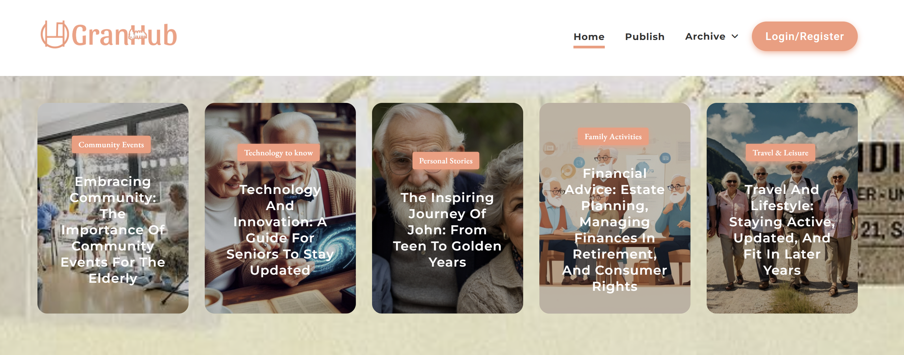
Granhub isn’t just a website. It’s a movement to reconnect generations, enrich families, and create lasting legacies. With your support, we can scale Granhub into the go-to global hub for grandparents and families everywhere.
Together, we can turn wisdom into impact, and family bonds into a sustainable business opportunity.

Slide 12
Thanks for watching

